Slide 1


OpenShift Networking
Oren Oichman
Red Hat - Cloud Architect

Slide 2

Table oc content
OPENSHIFT NETWORKING | Architecture design
Routes and Ingress
OpenShift SDN
Alternatives for ingress
KubernetesOVN
Egress traffic controls
Multus
Cluster DNS
DNS Load Balancing
CNI Echosystem
Meal LB

Slide 3
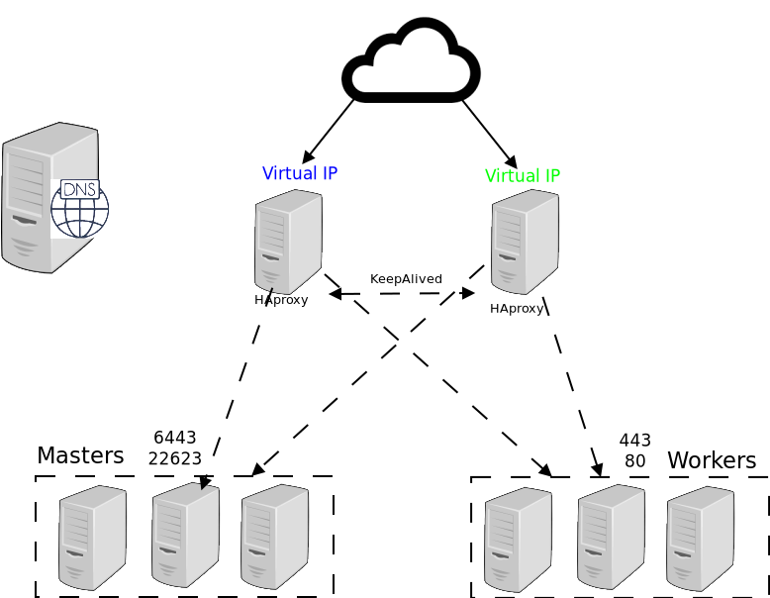
From Top to Bottom
OPENSHIFT NETWORKING | Architecture design

Slide 4


Alternative Architectures
OPENSHIFT NETWORKING | Architecture design
Can we run without DNS
Can we Run without Load Balancer
Do we really need (at least )3 masters and 3 workers

Slide 5
Load Balancing and DNS with OpenShift
For physical, OSP, RHV, and vSphere IPI deployments

Slide 6



On-prem OpenShift IPI DNS and Load Balancer
OpenShift 4, introduced a new way of doing DNS and load balancing for the api, api-int, DNS, and *.apps (Ingress) endpoints.
This method was originally used by the Kubernetes-native Infrastructure concept when creating bare metal clusters
mDNS
Excruciating detail: https://github.com/openshift/installer/blob/master/docs/design/baremetal/networking-infrastructure.md

Slide 7




keepalived
Used to ensure that the API and Ingress (*.apps) Virtual IPs (VIP) are always available
Utilizes Virtual Router Redundancy Protocol (VRRP) to determine node health and elect an IP owner
Only one host owns the IP at any time
All nodes have equal priority
Failover can take several seconds
Node health is checked every one second
Separate checks for each service (API, Ingress/*.apps)
ARP is used to associate the VIP with the owner node’s interface
VIP
Active node uses RARP to claim traffic
Health status checks
Active node passes traffic to endpoint

Slide 8

API load balancer
Client creates a new request to api.cluster-name.domain.name
HAProxy on the node actively hosting the API IP address (as determined by keepalived) load balances across control plane nodes using round robin
The connection is forwarded to the chosen control plane node, which responds directly to the client, a.k.a. “direct return”
3
1
2
Control plane nodes
Notes:
Refer to here and here for details on how HAProxy forwards traffic and the path data takes (thanks to Fred Herrmann for details!)

Slide 9

Ingress load balancer
The VIP, managed by Keepalived, will only be hosted on nodes which have a Router instance
Nodes without a Router continue to participate in the VRRP domain, but fail the check script, so are ineligible for hosting the VIP
Traffic destined for the *.apps Ingress VIP will be passed directly to the Router instance
Worker / Infra nodes

Slide 10
Requirements and limitations
Multicast is required for the Keepalived (VRRP) and mDNS configuration used
VRRP needs layer 2 adjacency to function
All control plane nodes must be on the same subnet
All worker nodes capable of hosting a router instance must be on the same subnet
The VIPs must be on the same subnet as the hosts
Ingress (*.apps) throughput is limited to a single node
Keepalived failover will result in disconnected sessions, e.g. oc logs -f <pod> will terminate
Failover may take several seconds
There cannot be more than 119 on-prem IPI cluster instances on the same L2 domain
Each cluster uses two VRRP IDs (API, ingress)
The function used to generate router IDs returns values of 1-239
There is no collision detection between clusters for the VRRP ID
The chance of collision goes up as additional clusters are deployed
Notes:
Here is the trail for #5...
VRRIP IDs are used in the keepalived conf here and here (also applies for other on-prem IPI)
The IDs are generated using the baremetal-runtimecfg utility with this function
The function above uses an implementation of the fletcher checksum based on the cluster name
The result is checked for internal collisions (do the API and ingress IDs match?) but there is no logic to check if there is an existing VRRP instance running with that ID
To check for and prevent VRRP ID collisions, use the command “podman run quay.io/openshift/origin-baremetal-runtimecfg:4.5 vr-ids <cluster name>” for each of the clusters. Note that this is documented here.

Slide 11
Alternatives
“I don’t like this,” “I can’t use this,” and/or “this does not meet my needs”. What other options are there?
Ingress
3rd party partners, such as Haproxy , Nginx, F5 and Citrix, have certified Operators that are capable of replacing the Ingress solution as a day 2 operation
API
There is no supported way of replacing the API Keepalived + HAProxy configuration
DNS
There is no supported way of replacing DNS in this configuration
DHCP
DHCP is required for all IPI deployments, there is no supported way of using static IPs with IPI
Remember that IPI is opinionated. If the customer’s needs cannot be met by the IPI config, and it’s not an option to reconfigure within the scope of supported options, then UPI is the solution. Machine API integration can be deployed as a day 2 operation for node scaling.

Slide 12
routes
and
ingress
How traffic enters the cluster

Slide 13
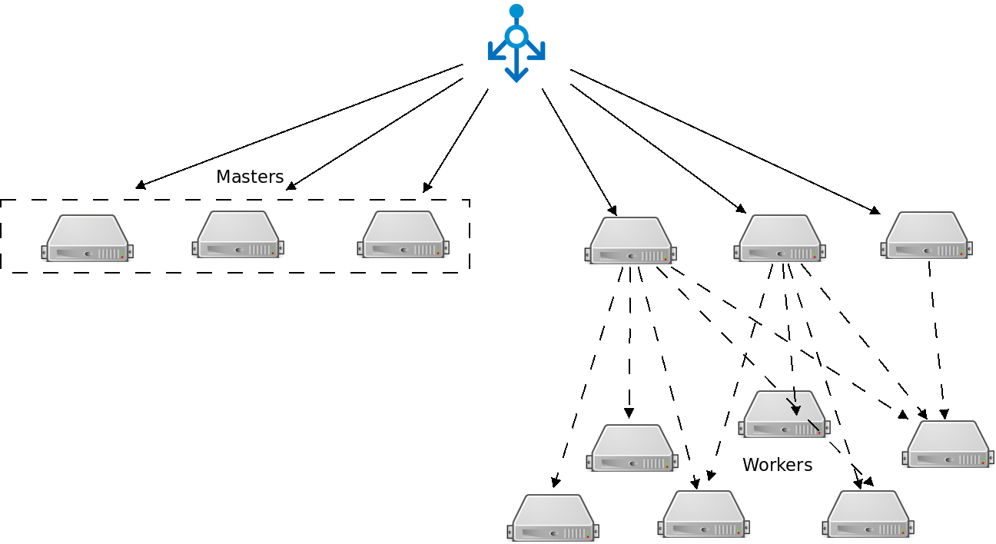
Route distribution (CVR)
OPENSHIFT NETWORKING | Routes and Ingress

Slide 14
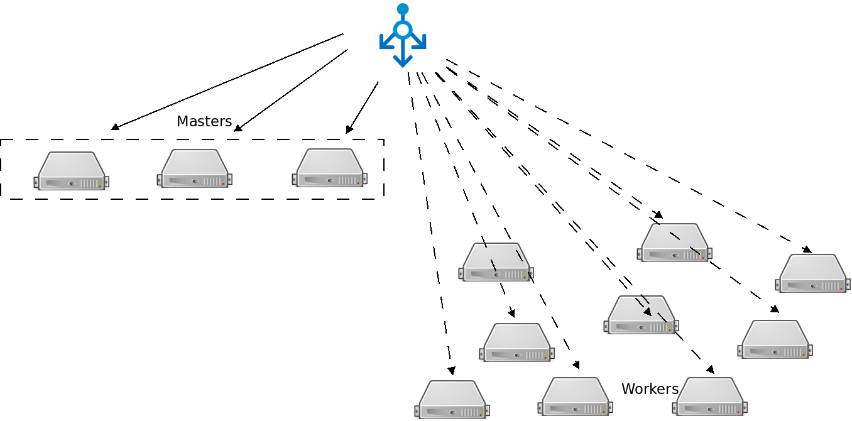
Route distribution (DVR)
OPENSHIFT NETWORKING | Routes and Ingress

Slide 15


Routing and Load Balancing
OPENSHIFT NETWORKING | Routes and Ingress
Pluggable routing architecture
HAProxy Router
F5 Router
Multiple-routers with traffic sharding
Router supported protocols
HTTP/HTTPS
WebSockets
TLS with SNI
Non-standard ports via cloud load-balancers, external IP, and NodePort

Slide 16

Router-based deployment methodologies
OPENSHIFT NETWORKING | Routes and Ingress
Split Traffic Between Multiple Services For A/B Testing, Blue/Green and Canary Deployments
ROUTE
90% traffic
10% traffic
SERVICE A
SERVICE B
App A
App A
App B
App B

Slide 17
Route Sharding
OPENSHIFT NETWORKING | Routes and Ingress

Slide 18
Alternative methods for ingress
Different ways that traffic can enter the cluster without the router

Slide 19
Entering the cluster on a random port with service nodeports
OPENSHIFT NETWORKING | Alternative methods
NodePort binds a service to a unique port on all the nodes
Traffic received on any node redirects to a node with the running service
Ports in 30K-60K range which usually differs from the service
Firewall rules must allow traffic to all nodes on the specific port
CLIENT
connect 192.10.0.10:31421
192.10.0.11:31421
192.10.0.12:31421
SERVICE
INT IP: 172.1.0.20:90
POD 10.1.0.1:90
POD
10.1.0.2:90
POD
10.1.0.3:90
NODE 192.10.0.10
NODE 192.10.0.11
NODE 192.10.0.12
Notes:
NodePort allow exposing non-standard ports for a service on all nodes in the cluster
If the node receiving the traffic doesn't have the target service running, the traffic is redirected to a node which has the pod running
While it is easier to configure than external IPs and Ingress (prev slide), it is a wasteful use of scarce port resources and it requires more privileges.

Slide 20
External traffic to a service on any port
with external IP
OPENSHIFT NETWORKING | Alternative methods
Access a service with an external IP on with Metal LB any TCP/UDP port, such as
Databases
Message Brokers
Automatic IP allocation from a predefined pool using Ingress IP Self-Service
IP failover pods provide high availability for the IP pool (fully supported in 4.8)
CLIENT
connect 200.1.0.10:90
SERVICE
EXT IP: 200.1.0.10:90
INT IP: 172.1.0.20:90
POD 10.1.0.1:90
POD
10.1.0.2:90
POD
10.1.0.3:90
NODE 192.10.0.10
NODE 192.10.0.11
NODE 192.10.0.12
Notes:
External IP allows assigning an external IP to a service so that client outside of the OpenShift cluster can connect to services inside the Openshift cluster (e.g. database, JMS broker) on that port. This is particularly useful for services that are running on ports other than 80/433, otherwise router is a more suitable alternative. It is also useful when the client needs to know a specific IP for the service in order to open firewalls or while-list it in their own system.
Each external IP address is guaranteed to be assigned to a maximum of one service. This ensures that each service can simply expose its chosen ports regardless of the ports exposed by other services.
The external IP address itself is not managed by the underlying Kubernetes infrastructure and must be maintained and provided by a cluster administrator. Managing external IPs is not convenient since application users cannot create external IP addresses themselves, and must work with cluster administrators to allocate an address for their usage. There is also no protections in place to restrict the usage of a particular external address configured within the cluster.
Ingress IP self-service is a functionality within OpenShift to streamline the allocation of External IP’s for accessing to services in the cluster. Cluster administrators can designate a range of addresses using a CIDR notation which allows an application user to make a request against the cluster for an external IP address. When a service is configured with the type LoadBalancer, an External IP address will be automatically assigned from the designated range.
Ingress is supported for non-cloud clusters. For cloud (GCE, AWS, and OpenStack) clusters, cloud provider’s load balancer service can be used to automatically deploy a load balancer to target the service’s endpoints.
The IP failover pods are responsible for providing the external IP range (Virtual IPs) and would run on one or more of the nodes (more than one for high availability) in the cluster or they can just run on the HAProxy (router) nodes.
The OpenShift cluster administrator must ensure that the external IP address pool terminates at one or more nodes in the cluster.

Slide 21
Cluster DNS
An automated system for providing hostname resolution within kubernetes

Slide 22
CoreDNS
OPENSHIFT NETWORKING | CoreDNS
Built-in internal DNS to reach services by a (fully qualified) hostname
Split DNS is used with CoreDNS
CoreDNS answers DNS queries for internal/cluster services
Other defined “upstream” name servers serve the rest of the queries

Slide 23
CNI Ecosystem
A pluggable model for network interface controls in kubernetes

Slide 24
OpenShift Networking Plug-ins
OPENSHIFT
KUBERNETES CNI
OpenShift SDN
OVN
Tigera Calico (open src)
Cisco ACI
VMware NCP
Isovalent
Cilium
VMware Antrea
Juniper Contrail
kuryr-
kubernetes²
DEFAULT
4.x
4.6+
4.2+
4.4+
4.4+
4.5+
4.6+
Q3CY2021
4.2.2+
3rd-party Kubernetes CNI plug-in certification primarily consists of:
Formalizing the partnership
Certifying the container(s)
Certifying the Operator
Successfully passing the same Kubernetes networking conformance tests that OpenShift uses to validate its own SDN
RH-OSP
Neutron
Plugin
Interoperability Support Matrix
Fully Supported
Tech Preview
Cert In-Progress
Version 2021-09-20
Product Manager: Marc Curry
Notes:
The list of Red Hat GA’d CNI plugins is here: https://access.redhat.com/articles/4763741
The public-facing list of third-party certified CNI plugins is here: https://access.redhat.com/articles/5436171

Slide 25
More in OpenShift 4
OpenShift Architecture
External IP Address for a Namespace
Cluster Admins can set Manually or dynamically IP address for each project (namespace
The default CNI plugin is NetworkPolicy
Admins can configure only ingress allowed services to the namespace
Cluster admins can configure egress traffic for each namespace (block/allowed CIDRs)

Slide 26
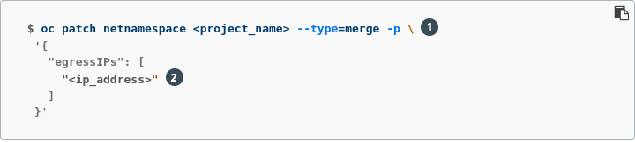
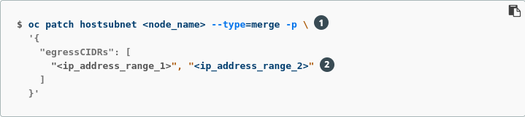
OpenShift 4 Namespace IP

Slide 27
Controlling egress traffic
OPENSHIFT NETWORKING | Egress Traffic Control
Egress IP high availability (multiple IPs)
PROJECT B
NODE 1
IP 1
IP 1
POD
NODE 2
IP 2
PROJECT A
Egress IP: IP 4 (Node 2) IP 5 (Node 3)
EXTERNAL SERVICE
Whitelist: IP 4, IP 5
POD
✓
EGRESS
HANDLER
IP 4
✓
IP 4
POD
✓
NODE 3
IP 3
POD
EGRESS
HANDLER
IP 5
Notes:
Egress IPs, as opposed to egress router which is deployed as a pod, are OpenShift construct and are configured on the node via modifying the node object e.g. via:
oc patch hostsubnet node2 -p '{"egressIPs": ["IP 4"]}'
oc patch hostsubnet node3 -p '{"egressIPs": ["IP 5"]}'
The egress IPs have nothing to do with the IPs normally assigned to the host interfaces.
Project admins can then assign one or multiple egress IPs (for failover) to a project, which would force all traffic from the pods in that project (regardless of which nodes they are running on) to use the primary egress IP as the source IP. Note that in this case, the OSV flows will be set up automatically to redirect any traffic from the project to the node that has the primary egress IP (Node 2 on the slide) and then send to the destination from there.

Slide 28
Controlling egress traffic
OPENSHIFT NETWORKING | Egress Traffic Control
Egress IP high availability (multiple IPs)
PROJECT B
NODE 1
IP 1
IP 1
POD
NODE 2
IP 2
PROJECT A
Egress IP: IP 4 (Node 2) IP 5 (Node 3)
EXTERNAL SERVICE
Whitelist: IP 4, IP 5
POD
✓
EGRESS
HANDLER
IP 4
POD
IP 4 failed!
✓
✓
NODE 3
IP 3
IP 5
POD
EGRESS
HANDLER
IP 5
Notes:
In case of failure (node crashes, etc) of the primary egress IP (IP 4), OSV will automatically configure the traffic flows so that traffic from all pods in the project go through the node that owns the secondary egress IP (Node 3 on the slide) and use that egress IP (IP 5) as the source IP of all traffic.

Slide 29
Controlling egress traffic
OPENSHIFT NETWORKING | Egress Traffic Control
Egress IP high availability (single IP)*
PROJECT B
NODE 1
IP 1
IP 1
POD
NODE 2
IP 2
PROJECT A
Egress IP: IP 4 (Node 2) IP 5 (Node 3)
EXTERNAL SERVICE
Whitelist: IP 4
POD
✓
EGRESS
HANDLER
POD
IP 4 failed!
✓
✓
NODE 3
IP 3
IP 4
POD
EGRESS
HANDLER
* coming soon
Notes:
The current HA Egress source IP feature requires that multiple egress IP addresses be whitelisted on the service endpoint and/or edge router, an often valuable commodity in the data center.
We are targeting an optional variation of the functionality which enables the ability to use a single IP that can be migrated from its current, failed node to a healthy node (“fully automatic”). While a single HA IP is more efficient use of the address space and easier to manage, additional steps are required in the IP-moving solution that would take several (valuable) seconds to complete, and may not be suitable for delay-sensitive customers:
the master must update a HostSubnet object with the new IP assignments
the nodes would have to observe that change and react to it
For this reason, we’ll eventually make both options available as a choice.

Slide 30
OpenShift 4 NetworkPolicy
NetworkPolicy is only for the engress rules (egress has different configuration)
A network policy can define only one egress rule
Once one or more network policies are defined an implicit deny is being configured automatically.
We use Network Policy to control the TCP/UDP traffic within the namespace. (layer 4)

Slide 31

OpenShift 4 NetworkPolicy - Example
apiVersion: networking.k8s.io/v1 kind: NetworkPolicy Metadata: name: allow-from-openshift-ingress spec: ingress: - from: - namespaceSelector: matchLabels: network.openshift.io/policy-group: ingress podSelector: {} policyTypes: - Ingress
apiVersion: networking.k8s.io/v1 kind: NetworkPolicy Metadata: name: allow-pgsql-from-project_name spec: podSelector: matchLabels: name: test-pods ingress: - ports: - protocol: TCP port: 5432 - from: - namespaceSelector: matchLabels: project: project_name podSelector: matchLabels: name: test-pods

Slide 32
OpenShift SDN
An Open vSwitch-based Software Defined Network for kubernetes

Slide 33
OpenShift SDN “flavors”
OpenShift Architecture
OPEN NETWORK (Default)
All pods can communicate with each other across projects
MULTI-TENANT NETWORK
Project-level network isolation
Multicast support
Egress network policies
PROJECT A
PROJECT B
PROJECT C
DEFAULT NAMESPACE
NODE
NODE
✓
POD
POD
POD
POD
POD
POD
POD
POD
Multi-Tenant Network
Notes:
OpenShift 4 clusters are using OpenShift SDN NetworkPolicy as the default networking solution. The default behavior is wide-open network across projects/namespaces (no policies applied). It is possible to install the cluster in a multitenant mode as an install-time configuration option. In this scenario, all projects/namespaces are network isolated from each other by default, but all can be accessed by the router and can access the cluster registry and other internal services. When installed in this mode, the SDN operator configures the cluster’s project request template to ensure that all new projects/namespaces have isolating policy objects.

Slide 34
OPENSHIFT PLATFORM
SDN (Re)configuration
spec:
defaultNetwork:
type: OpenShiftSDN
openshiftSDNConfig:
mode: NetworkPolicy
vxlanPort: 4789
mtu: 1450
useExternalOpenvswitch: false
Networking Advanced Settings
These are the OpenShift SDN settings that can be tweaked at install-time:
Mode: NetworkPolicy, Multitenant, Subnet
VXLAN Port Number
MTU (autodetected, once)
External OpenVSwitch
How to Modify Advanced Network Configuration Parameters
NOTE: Most network settings cannot be changed safely and affect the entire cluster. The operator will prevent unsafe changes. If you need to force a change to a non-production cluster, see the operator README for the command, but a cluster re-install is likely to be the better choice.
Product Manager: Marc Curry
Generally Available
Notes:
The default Mode is NetworkPolicy in 4.x.
The operator will use its host MTU to auto-calculate a reasonable default value for the cluster MTU. For example, on AWS (MTU 9001), the MTU will be set to 9001 - 50 = 8951, automatically (VXLAN consumes 50 bytes/packet, so the number is adjusted to accommodate).

Slide 35
OPENSHIFT PLATFORM
kube-proxy Re-configuration
spec:
kubeProxyConfig:
iptablesSyncPeriod: 30s
bindAddress: 0.0.0.0
proxyArguments:
iptables-min-sync-period: ["30s"]
kube-proxy Advanced Settings
These are the kube-proxy settings that can be tweaked at install-time:
iptablesSyncPeriod
bindAddress
proxyArguments (a list of kube-proxy command-line flags)
How to Modify Advanced Network Configuration Parameters
NOTE: Most network settings cannot be changed safely and affect the entire cluster. The operator will prevent unsafe changes. If you need to force a change to a non-production cluster, see the operator README for the command, but a cluster re-install is likely to be the better choice.
Product Manager: Marc Curry
Generally Available
Notes:
All settings are configured with reasonable defaults for most cluster implementations.

Slide 36


OpenShift SDN high-level architecture
OpenShift Architecture
NODE 172.16.1.10
NODE 172.16.1.20
POD 10.1.2.2
POD 10.1.2.4
VxLAN Overlay Network
POD 10.1.4.2
POD 10.1.4.4
IP Network
Notes:
Pods are connected via an overlay network which enables IP-per-Pod networking and direct pod-to-pod communication
The Pod IPs are independent of the physical network the OpenShift Nodes are connected to

Slide 37
OpenShift SDN packet flows
container-container on same host
OpenShift Architecture
NODE
POD 1
veth0 10.1.15.2/24
br0 10.1.15.1/24
vxlan0
eth0
POD 2
192.168.0.100
veth1 10.1.15.3/24

Slide 38
OpenShift SDN packet flows
container-container across hosts
OpenShift Architecture
NODE 1
POD 1
veth0 10.1.15.2/24
br0 10.1.15.1/24
vxlan0
eth0
192.168.0.100
NODE 2
POD 2
veth0 10.1.20.2/24
br0 10.1.20.1/24
vxlan0
eth0
192.168.0.200

Slide 39
OpenShift SDN packet flows
container leaving the host
OpenShift Architecture
Container to Container on Different Hosts
NODE 1
External Host
POD 1
veth0 10.1.15.2/24
br0 10.1.15.1/24
tun0
eth0
192.168.0.100

Slide 40
OVN
A Kubernetes-native networking solution

Slide 41
OVN Cluster Architecture
Project:
OVN = Open Virtual Network
OVN is a network virtualization platform based on Open vSwitch (OVS)
Originally part of the OVS project, now a Linux Foundation project
OVN
databases/
daemons
Kubernetes/
OpenShift
control plane
ovn-kubernetes
master
Control Plane
Open vSwitch
(OVS)
OVN
node
components
Features:
Manages overlays and physical network connectivity
Flexible security policies (ACLs)
Distributed L3 routing, IPv4 and IPv6, L2/L3 Gateways
Native support for NAT, load balancing, DHCP and RA
Works with Linux, DPDK, and Hyper-V
ovn-kubernetes
node
kubelet and
CRI-O
Worker Nodes

Slide 42
Control Plane Architecture
ovn-kubernetes master
Deployment created by Cluster Network Operator
Multiple instances elect a leader
Kubernetes API is the single source of truth
Listens for cluster events (Pods, Namespaces, Services, Endpoints, NetworkPolicy)
Translates cluster events to OVN logical network elements (logical switches, ACLs, logical routers, switch ports)
Handles all required IPAM
Updates OVN Northbound database based on Kube API state
Kubernetes
apiserver
ovn-kubernetes
master
OVN
Northbound DB
Cluster Network Operator
ovn-northd
Multiple instances managed by ovn-kubernetes master
Listens for Northbound DB changes
Decomposes logical network elements into OVN pipeline and populates the Southbound DB
Keeps no state itself (eg "cattle")
ovn-northd
OVN
Southbound DB
Nodes
Notes:
Cluster Network Operator controls configuration and lifecycle of ovn-kubernetes control plane (masters and nodes)
Master has no direct interaction with data plane
All components can be replicated to maintain high availability
active/passive
RAFT

Slide 43
Worker Node Architecture
ovn-kubernetes node
-Called as a CNI plugin from kubelet/CRI-O runtime
-Retrieves IPAM details from Kube API (written by ovn-kubernetes master)
-Creates OVS port on bridge, moves it into pod network namespace, sets IP details/QoS
-Cleans up when pods die
-Sets up "gateway" for cluster-external network access
-Sets up firewall rules and routes for HostPort and Service access from node
apiserver
OVN southbound database
ovn-controller
-Listens for events from OVN Southbound database
-Translates Southbound database into OpenFlow and programs local OVS vSwitch
-Matches OVS "physical" ports with OVN logical ports
-Updates kernel netfilter tables for load balancing functionality (no iptables in critical path)
kubelet/
CRI-O
ovn-controller
Open vSwitch
-The actual datapath for containers
-Performs packet handling based on OpenFlow rules
-Kernel module and userspace management daemon
-If kernel does not recognize a flow, calls up to management daemon to determine packet action, then caches the match+action for later
ovn-kubernetes
node
OVS database
podA
OVS bridge
podA
Cluster /other networks
podA
NIC
Node
Notes:
Node components run as a HostNetwork kubelet-managed daemonset on every node
Nodes communicate using the standard GENEVE protocol

Slide 44
Multus
A CNI plugin that provides multiple network interfaces for pods

Slide 45
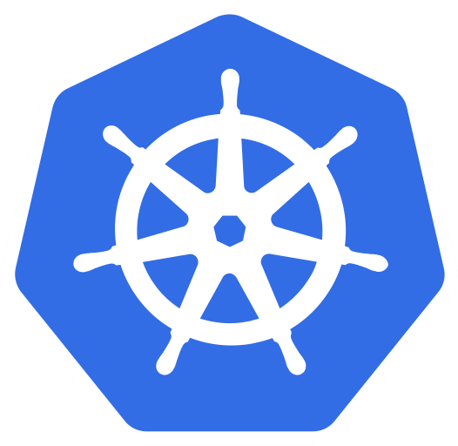


OPENSHIFT PLATFORM
Multinetwork with Multus
Kubernetes
Multus CNI
CNI
CRDs
The Multus CNI “meta plugin” for Kubernetes enables one to create multiple network interfaces per pod, and assign a CNI plugin to each interface created.
OpenShift
SDN CNI
eth0
pod
Additional networks and capability
CNI
net0
CNI
net1
...
Notes:
Multus Enables Multiple Networks & New Functionality to Existing Networking
The Multus CNI “meta plugin” for Kubernetes enables one to create multiple network interfaces per pod, and assign a CNI plugin to each interface created.
Create pod annotation(s) to call out a list of intended network attachments...
...each pointing to CNI network configurations packed inside CRD objects
Multus allows pods to have multiple network interface connections that can address various use cases; for example:
Splitting the control/data plane traffic, mostly applicable to vnf/cnf applications
Legacy/storage intensive applications
Multitenant networks

Slide 46
Additional OpenShift-Supported Secondary CNI Plug-Ins
OPENSHIFT PLATFORM
OpenShift 4.x Tested Integrations: Network Components and Plugins
host device
IPAM(dhcp)
MACVLAN
IPVLAN
Bridge with VLAN
Static IPAM
DHCP IPAM
Route Override
whereabouts
SR-IOV
...
Notes:
Initial ARM support targets nVidia/Mellanox collaboration for BlueField-2 DPU.

Slide 47

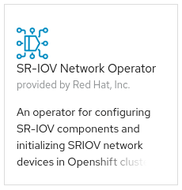
OPENSHIFT PLATFORM
SR-IOV
eth0
primary
pod
SR-IOV CNI
net0
SR-IOV
SR-IOV device plug-in
Notes:
OCP 4 includes the capability to use SR-IOV hardware on nodes, which enables you to attach SR-IOV virtual function (VF) interfaces to Pods in addition to other network interfaces.
Two components are required to provide this capability: the SR-IOV network device plug-in and the SR-IOV CNI plug-in:
The SR-IOV network device plug-in is a Kubernetes device plug-in for discovering, advertising, and allocating SR-IOV network virtual function (VF) resources. Device plug-ins are used in Kubernetes to enable the use of limited resources, typically in physical devices. Device plug-ins give the Kubernetes scheduler awareness of which resources are exhausted, allowing Pods to be scheduled to worker nodes that have sufficient resources available.
The SR-IOV CNI plug-in plumbs VF interfaces allocated from the SR-IOV device plug-in directly into a Pod.
Further detailed information on the very specific NIC models that we are initially targeting for SR-IOV implementation:
* Intel XXV710-DA2 25G card with vendor ID 0x8086 and device ID 0x158b
* Mellanox MT27710 Family [ConnectX-4 Lx] 25G card with vendor ID 0x15b3 and device ID 0x1015
* Mellanox MT27800 Family [ConnectX-5] 100G card with vendor ID 0x15b3 and device ID 0x1017
(See also: https://github.com/openshift/openshift-docs/pull/14563/files#diff-56052e748d888ef434f910606f960260R32)
We will add more NICs in future releases.

Slide 48




OPENSHIFT PLATFORM
High-performance multicast
eth0
primary
pod
net0
SR-IOV
Notes:
Achive high performance by attaching an SR-IOV device to your pod as a second network interface

Slide 49
Egress traffic controls
Security mechanisms for controlling traffic leaving the cluster

Slide 50
Controlling egress traffic
OPENSHIFT NETWORKING | Egress Traffic Control
default kubernetes behavior
PROJECT B
NODE 1
IP 1
EXTERNAL SERVICE
Whitelist: IP1
POD
✓
PROJECT A
POD
NODE 2
IP 2
POD
Notes:
Pod traffic by default comes from the IP of the node that the pod is running on and therefore the external service needs to whitelist the IP of all nodes that a certain application might be scheduled on.
Advantage: simple to configure as not special configuration is needed on OpenShift other than making sure (via labeling) pods which need to access the external service are scheduled on the node that is whitelisted
Disadvantage: whitelisting is not very granular and any pod scheduled on the whitelisted node can access the external service

Slide 51
Controlling egress traffic
OPENSHIFT NETWORKING | Egress Traffic Control
Egress router
PROJECT B
NODE 1 IP 1
POD
*
NODE 2 IP 2
EXTERNAL SERVICE
Whitelist: IP 3
PROJECT A
POD
✓
EGRESS SERVICE INT-IP
EGRESS
ROUTER IP 3
POD
**
* Blocked by multi-tenant network / networkpolicy plugin ** Blocked by external service
Notes:
Egress router runs a service that redirects (proxies) traffic to a specified remote server, using a private source IP address that is not used for anything else. The service allows pods to talk to servers that are setup to only allow access from whitelisted IP addresses. When deploying an egress router, an IP address from the physical network that the node itself is on is reserved by the cluster administrator to be used by the egress router.
Application pods access the external service using the egress service on the service internal IP address or service name. The egress service redirects the traffic to the egress routers which in turn send the traffic to the external service with the egress IP (reserved on the node it’s running on) as the source IP. The external service accepts the traffic since the source IP (egress router IPs) is whitelisted.
Multiple egress IPs (egress pods) can be configured (one on each node) so that if cluster detects that one egress IP has stopped working (node failure), it would fail over and use another egress IP on the other nodes that are preconfigured.

Slide 52

Controlling egress traffic
OPENSHIFT NETWORKING | Egress Traffic Control
Egress router
PROJECT B
PROJECT A
NODE 1 IP 1
Failover to standby egress router
POD
EGRESS
ROUTER IP 3
*
NODE 2 IP 2
EXTERNAL SERVICE
Whitelist: IP 3
PROJECT A
POD
✓
EGRESS SERVICE INT-IP
EGRESS
ROUTER IP1
POD
**
* Blocked by multi-tenant network plugin ** Blocked by external service
Notes:
Multiple egress IPs (egress pods) can be configured (one on each node) so that if cluster detects that one egress IP has stopped working (node failure), it would fail over and use another egress IP on the other nodes that are preconfigured.

Slide 53
MetalLB
L2-mode only in OpenShift 4.9

Slide 54
MetalLB - A load balancer for Kubernetes
A load balancer implementation which relies on L2 (ARP / NDP) or L3 (BGP) to advertise endpoints for Services with a type of LoadBalancer
Services can use IPv4 or IPv6, but not both for the same endpoint
Not applicable for hyperscaler-based cloud deployments which have native load balancer offerings
Use with on-prem RHV, vSphere, OSP, and bare metal deployments
OpenShift 4.9+ supports L2 mode
Advertises the LoadBalancer IP via ARP (IPv4) or NDP (IPv6)
Functionally similar to keepalived, one node hosts the IP address and receives all traffic, kube-proxy distributes traffic across Pods associated with the Service definition
L3 (BGP) mode is supported with OpenShift 4.10+
Uses BGP peering to advertise multipath routes
https://metallb.universe.tf/

Slide 55
MetalLB with OpenShift
Installed, deployed, and configured day 2+ using OperatorHub
Not a replacement for the default *.apps ingress endpoint nor the api endpoint
Provides an alternative method to expose Services which can, optionally, have an externally configured DNS name associated with them
Services receive an IP from a configured address pool
IP can be automatically assigned or specifically requested
IPs can be shared between multiple Services
Assigned IP will be configured and advertised by a speaker Pod, route(s) advertised to peer AS with BGP mode
If the node hosting the IP fails, is rebooted, etc. MetalLB will detect the failure, rehome the Service’s LoadBalancer IP, and readvertize within a few seconds
Failure detection uses memberlist
Notes:
See the documentation for full details

Slide 56
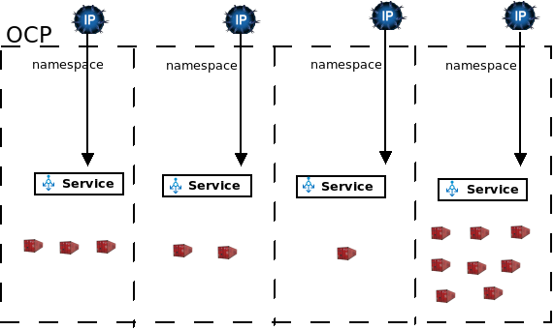
MetalLB with OpenShift

Slide 57
MetalLB Deployment - L2 mode
Service network
172.130.0.0/16
Pod network
10.128.0.0/14
Host network
192.168.100.0/24
MetalLB namespace
Node 1
Speaker
192.168.100.11
192.168.100.11
Node 2
Speaker
192.168.100.21
192.168.100.21
Node 3
Speaker
192.168.100.31
192.168.100.31
Notes:
Graphic is modified from the docs: https://docs.openshift.com/container-platform/4.9/networking/metallb/about-metallb.html.

Slide 58
Creating a Service with type LoadBalancer (L2 mode)
Service network
172.130.0.0/16
Pod network
10.128.0.0/14
Host network
192.168.100.0/24
MetalLB namespace
MetalLB namespace
apiVersion: v1
kind: Service
metadata:
name: nginx
spec:
ports:
- name: http
port: 80
protocol: TCP
targetPort: 80
selector:
app: nginx
type: LoadBalancer
LoadBalancer IP configured on the node
Node 1
App Pod
10.128.x.x
Speaker
192.168.100.11
Service
192.168.100.11
192.168.100.200
Cluster IP
172.130.x.x
Node 2
Speaker
192.168.100.21
LoadBalancer IP
192.168.100.200
192.168.100.21
Node 3
App Pod
10.130.x.x
Speaker
192.168.100.31
192.168.100.31
Notes:
Graphic is modified from the docs: https://docs.openshift.com/container-platform/4.9/networking/metallb/about-metallb.html.

Slide 59
Routing traffic to the application Pods (L2 mode)
External traffic uses the MetalLB assigned and configured LoadBalancer IP
Internal traffic uses the Service definition + kube-proxy
Pod-to-Pod comms happen across the SDN / Pod network
Host network
192.168.100.0/24
MetalLB namespace
MetalLB namespace
External traffic ingress
LB IP: 192.168.100.200
Node 1
App Pod
10.128.x.x
kube-proxy
Speaker
192.168.100.11
Service Network 172.130.0.0/16
192.168.100.11
192.168.100.200
Node 2
Speaker
192.168.100.21
Pod Network
10.128.0.0/14
192.168.100.21
Node 3
App Pod
10.130.x.x
Speaker
192.168.100.31
192.168.100.31
Notes:
Graphic is modified from the docs: https://docs.openshift.com/container-platform/4.9/networking/metallb/about-metallb.html.

Slide 60
Multi-NIC / multi-homed nodes (L2 mode)
Nodes may be configured with however many NICs, bonds, VLANs, etc. as needed for the environment
Nodes do not need to have an IP address on address pool networks for MetalLB to function
Address pools do not have any metadata about which network adapter to listen on
The IP address assigned from the address pool is configured to listen on all network interfaces
External routing must be configured to send traffic to the appropriate interface
ARP (IPv4) or NDP (IPv6) is used to identify where in the network the LoadBalancer IP is at
Identifying host configuration
View the Service (oc describe service) to identify the assigned speaker Pod
Use arping from an external host to identify the host MAC address with the IP assigned
Review speaker Pod logs for details of ARP requests/responses

Slide 61
Additional notes and details
Address pools can be in any range so long as the external network understands how to route traffic to the OpenShift cluster
A Service may request to be assigned an IP from any pool, a specific pool, or request a specific IP
Layer 2 mode...
Ingest is limited to a single node’s throughput for each Service
Has no limit on the number of load balancers per subnet
A single node (speaker) will ingest all traffic for the Service. View the assigned node using the oc describe service command
The externalTrafficPolicy option is supported
cluster (the default) uses kube-proxy to distribute traffic to all Pod(s) matching the Service definition, local results in traffic being sent only to the Pod(s) on the node hosting the IP

Slide 62
OpenShift IP failover
L2-mode only in OpenShift 4.9

Slide 63
OpenShift IP failover
OPENSHIFT NETWORKING | IP Failover
IP failover manages a pool of Virtual IP (VIP) addresses on a set of nodes. Every VIP in the set is serviced by a node selected from the set. As long a single node is available, the VIPs are served.
IP failover monitors a port on each VIP to determine whether the port is reachable on the node.
IP failover uses Keepalived to host a set of externally accessible VIP addresses on a set of hosts. Each VIP is only serviced by a single host at a time
Keepalived uses the Virtual Router Redundancy Protocol (VRRP) to determine which host, from the set of hosts, services which VIP.
https://metallb.universe.tf/

Slide 64
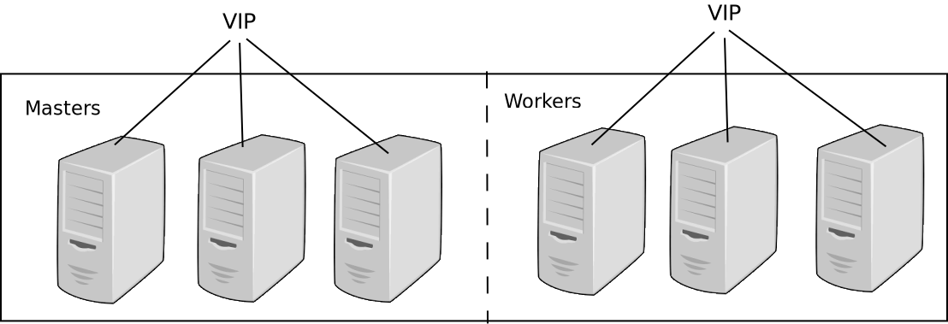
OpenShift IP failover - design
OPENSHIFT NETWORKING | IP Failover
https://metallb.universe.tf/

Slide 65

OpenShift IP failover
OPENSHIFT NETWORKING | IP Failover
With IP failover we can replace the Load Balancer and “move” the virtual IP of the API to the Masters
With IP failover we can replace the Load Balancer and “move” the virtual IP of the router to the Masters
A good practice of IP failover is adding it to the manifest in the installation stage.
The deployment uses the hostnetworking options to manage the external IPs
https://metallb.universe.tf/

Slide 66
Have Fun !!!
Red Hat is the world’s leading provider of enterprise open source software solutions. Award-winning support, training, and consulting services make Red Hat a trusted adviser to the Fortune 500.

